Slide 1
Smart study planner
CAPSTONE PROJECT
Presented By:
Student Name- PRIYADARSHINI PRADHAN
College Name-IPSAR,CUTTACK
AICTE internship registration ID –STU68849471314b01753519217

Slide 2
OUTLINE
Problem Statement (Should not include solution)
System Development Approach (Technology Used)
Algorithm & Deployment (Step by Step Procedure)
Result
Conclusion
Future Scope(Optional)
References

Slide 3
Problem Statement
Students often face challenges in organizing study schedules and tracking academic tasks
efficiently. Managing multiple subjects, assignments, and deadlines can become overwhelming
without a proper system. This Smart Study Planner helps users create, view, and manage their
study goals with reminders and visual timelines, improving time management and productivity. All
tasks and progress are stored locally using the browser’s LocalStorage, ensuring that data remains
available even after closing or refreshing the page

Slide 4
System Approach
Frontend Technologies:
HTML5 – Structure of the webpage
CSS3 – Styling and responsive layouts
JavaScript – Dynamic interactivity (cart, filtering, total calculation)
Design Approach:
Clean and user-friendly interface
Mobile-responsive design
Modular separation of HTML, CSS, and JS files
Platform-web brouser, Running and Testing the application
Storage –Localstorage ,storing and retrieving tasks locally.

Slide 5
Algorithm & Deployment
using HTML and CSS (grid & cards).
InteraFrontend Design
Layout ctive Features
Define product categories and details (image, price, description).
Add-to-Product Catalog Creation
Cart, Remove-from-Cart functions in JavaScript.
Real-time total price calculation.
Product filtering by category.
Modal views for product details.
Testing
Cross-browser compatibility
Mobile responsiveness
Deployment
Host using GitHub Pages / Netlify for free and easy access.

Slide 6
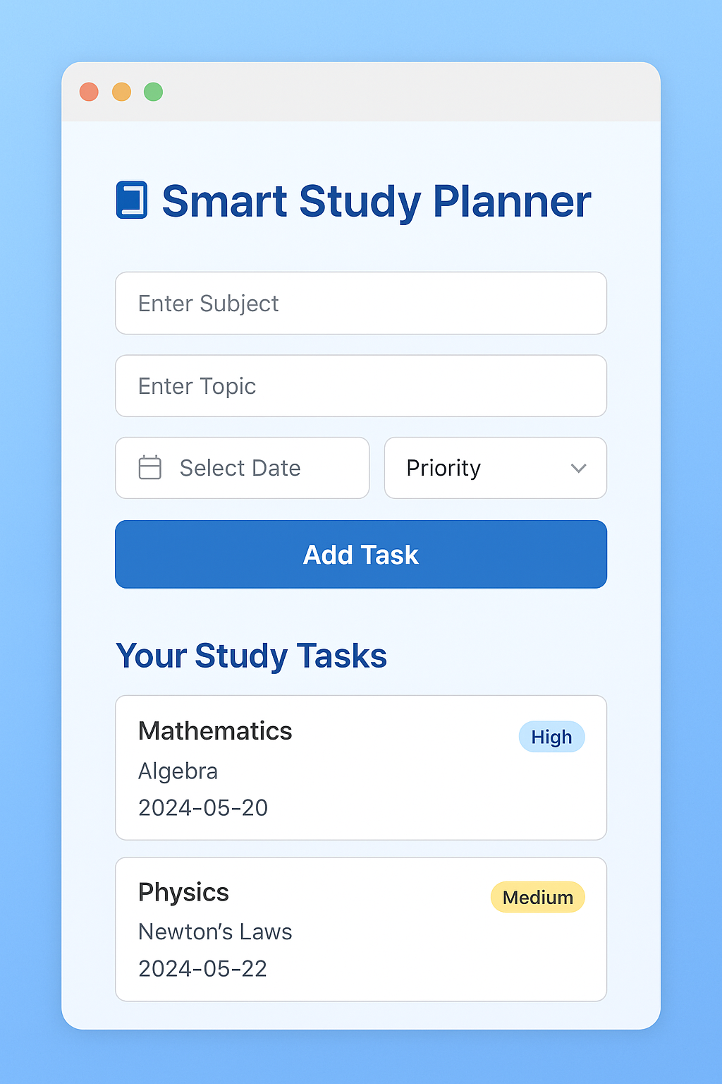
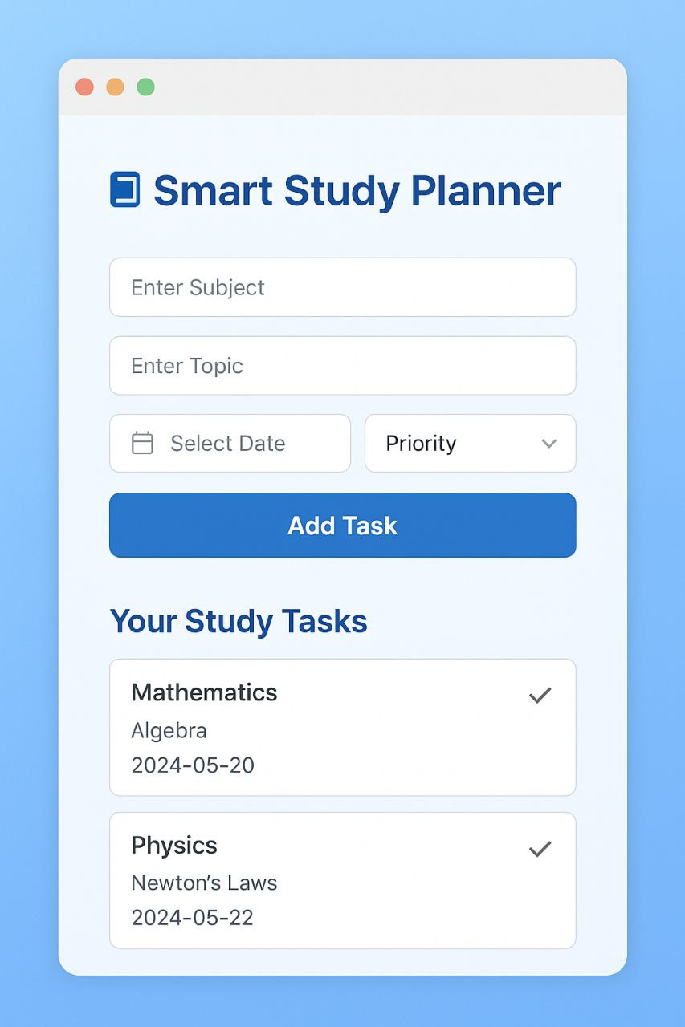
Result

Slide 7
Conclusion
The Smart Study Planner provides a practical and efficient way for students to organize their
academic goals. It demonstrates the effective use of HTML, CSS, and JavaScript along with
LocalStorage to create a fully functional offline web app. The project successfully addresses the
challenges of managing study schedules and enhances productivity, focus, and time management
among students..

Slide 8
Future scope(Optional)
Add reminder notifications for upcoming tasks.
Introduce progress tracking charts.
Implement dark/light mode toggle.
Add cloud backup for syncing across devices.
Include calendar view or visual timelines of tasks.

Slide 9
References
Mozilla Developer Network (MDN Web Docs) — Documentation for HTML, CSS, and JavaScript concepts used in this project.
W3Schools Online Web Tutorials — Used for understanding and implementing basic web technologies and LocalStorage usage.
Stack Overflow — Used to resolve implementation issues and enhance JavaScript functionality.
FreeCodeCamp — Referred for ideas on creating responsive layouts and project logic in JavaScript.
CSS Tricks — Referenced for modern CSS design patterns and layout improvements.
-NanthiniMoha/TNSDC-FWD-DIGITAL_PORTFOLIO
-Get started with Bootstrap · Bootstrap v5.3

Slide 10
THANK YOU

